Slide 1

Power BI Case Study -1
4th September 2024
Bourntec Solutions

Slide 2

Case Study 1 - Scope
Provide a summary dashboard containing product wise, Office and Industry wise billed value of policies.
It should only contain top 5 values for above dimensions.
Provide KPIs for Distinct Client numbers, Policy Numbers, Total Billed premium, Distinct Insurers and distinct coverages on top of dashboard.
Provide a drill-through report to get a view at account level AND policy level.
Add client premium group to the drill-through detailed page at account level.
Generate Unique IDs for Accounts and hide account names.
Add Last RefreshTime on the top
Add slicers on detailed page and hide it and expand slicers when required using an arrow key.
2

Slide 3
Case Study 1 - Scope
Year-over-Year Premium Growth
Create a YoY comparison card showing the total Estimated_premium this year vs. last year, along with the percentage growth.
Total Claims Paid – Current vs Previous Year
Active Policies Over Time
Create a line chart/table showing the count of active policies per month over the last two years. A policy is considered active if today falls between POLEFFDATE and PolicyEnddate
Active Policies Over Time
Create a line chart showing the count of active policies per month over the last two years. A policy is considered active if today falls between POLEFFDATE and PolicyEnddate
3

Slide 4
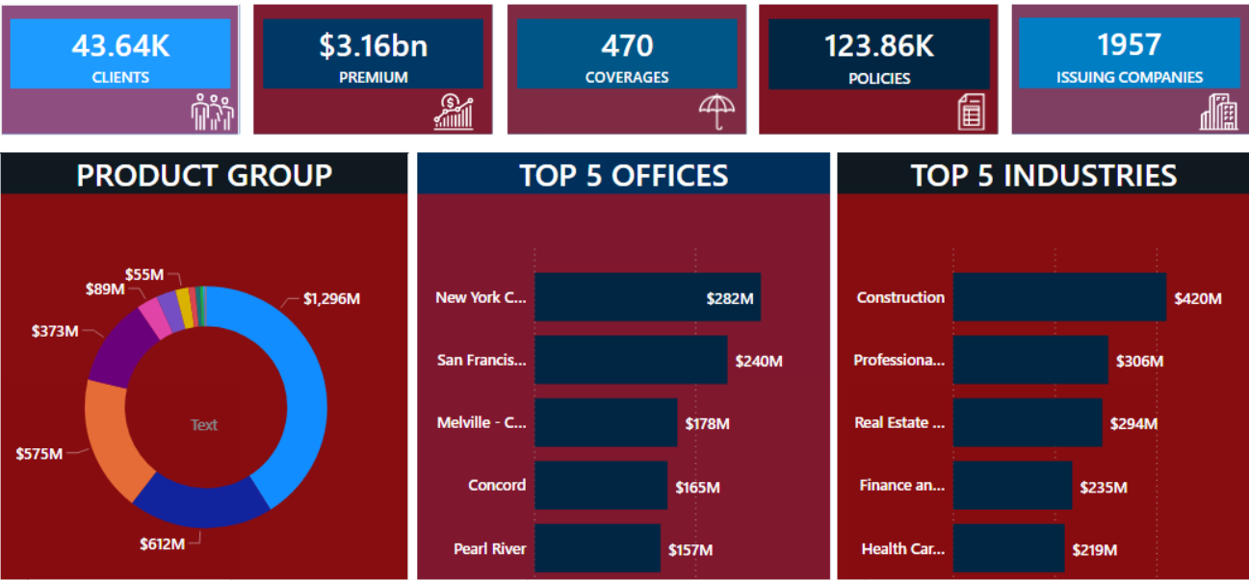
Case Study – Screen Layout
4

Slide 5
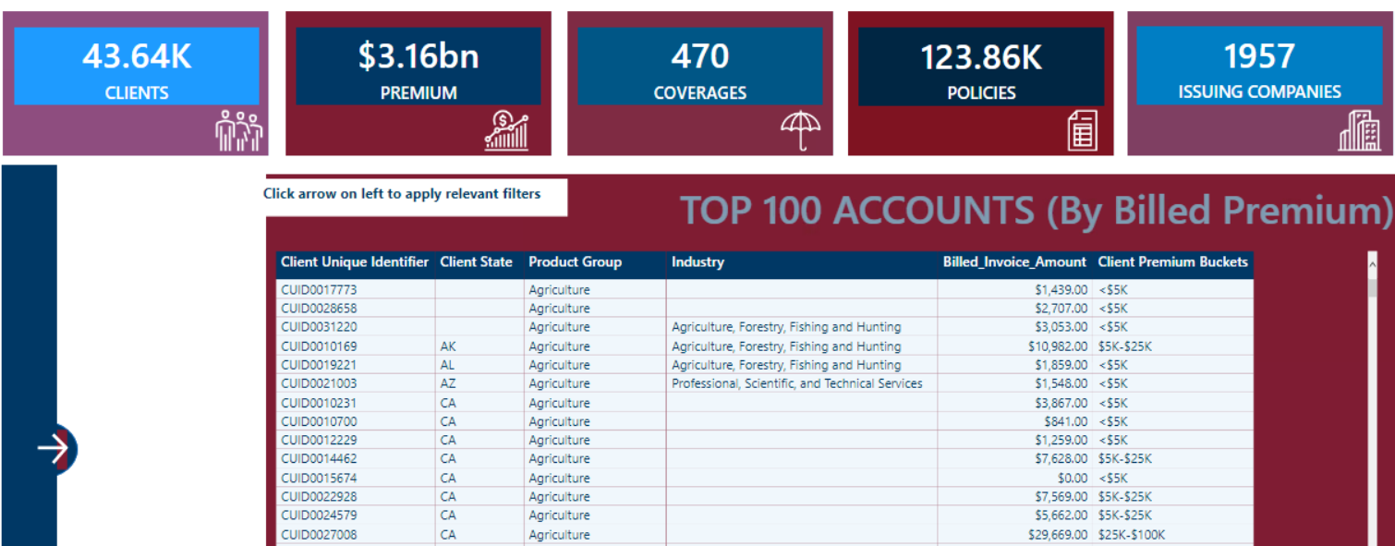
Case Study – Drill Down Account
5

Slide 6
Case Study 2 - Scope
Calculate percentage of billed premium of client w.r.t Enterprise, Product Group, Product segment and Coverage description.
Calculate percentage of billed premium of client w.r.t a selected value of product group.
Use Year, Quarter or Month as Period selector and date slicer to select actual period.
Find out Billed premium value of selected period Vs. billed premium of previous period.
Find out Billed premium value of selected period Vs. billed premium of same period last year.
Show the values in KPI form and compare with a UP or DOWN arrow mark to indicate increase or decrease.
Find out expiring policy within 90 to 120 days and display them. Make it dynamic to change the date range.
Display result of TOP N visualizations done in Case Study 1 dynamically based on user selection as Top 5, Top 10, Top 20 etc.
Provide a summary page to show No of policies renewed/added and expired in year, Quarter and Month view. Add Drill through report to view details of renewed/added policies or expired policies.
Find out premium for total active policies.
6

Slide 7
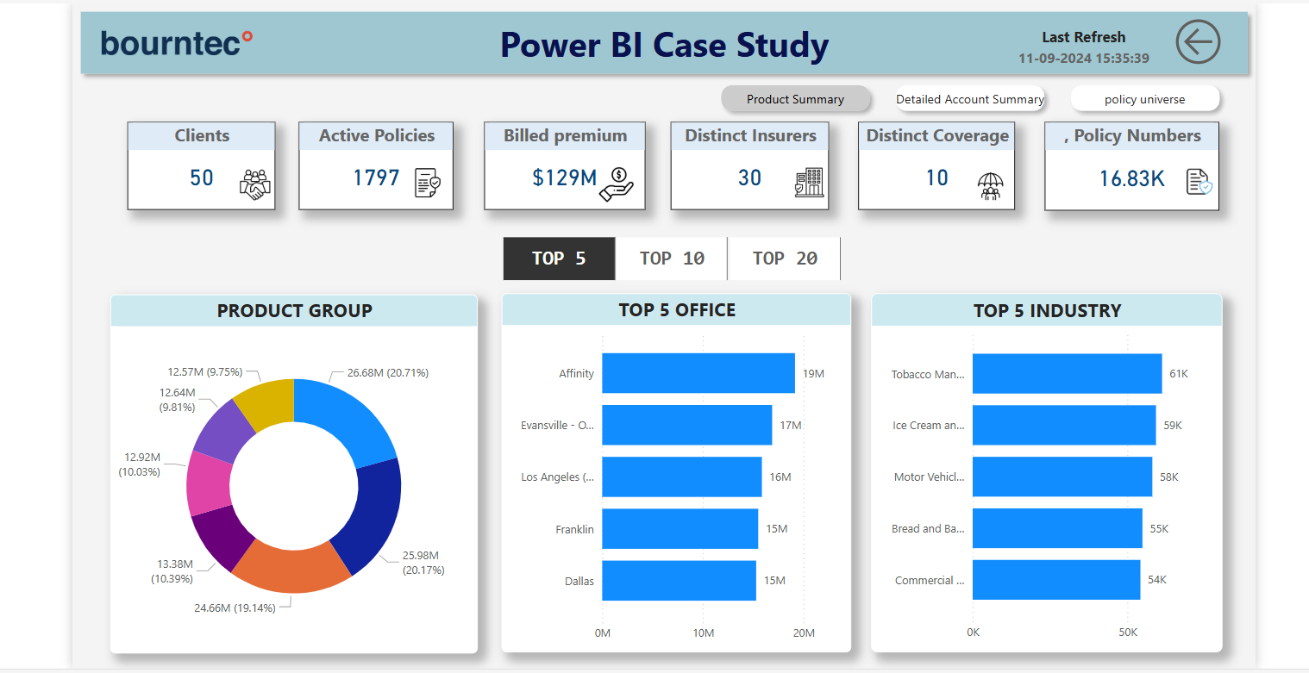

Slide 8
THANK YOU !

